Slide 1
Immersion Day Prep:
The content for this immersion day is 300 (optionally 400) level DynamoDB Architecture and NoSQL Data Modeling best practices. The intended outcome is to quickly enable development teams to start building on AWS using DynamoDB as a primary datastore. The combined sessions will build trust in DynamoDB as a Tier Zero service as well as provide a mental model to develop highly performant data models.
Recommended preparation prior to delivering the Immersion Day:
Under-the-Hood – this is a deep dive into DynamoDB’s Architecture and how it works.
Advanced Design Patterns – this is a collection, and explanation, of many data modeling examples.
Datacom Page for DynamoDB – this is a one stop shop for DynamoDB reference content, battle cards, white papers, power points, and more.

Slide 2
Immersion Day Prep:
We have a community support chime room to prep and coordinate help for a DynamoDB Event:
https://app.chime.aws/rooms/7c4f7413-d72a-4f7b-a626-8d5ba1cc27e6
The DynamoDB AoD community is a great place to find experienced folks to help with events:
https://w.amazon.com/bin/view/BigBird/SA/AoDProgram

Slide 3
Immersion Day FAQ: (1)
Below is a collection of FAQs that come up during a typical immersion day. A significant portion of the design patterns questions are related to understanding that the Database does not implement any logic – and that the design patterns represent ‘application side’ logic. Writing data in a specific way to retrieve it in a single optimized request is a fundamental mental shift from RDBMS.
Does the GSI create new attributes?
No. All attributes are written into the base table item, and selectively updated into the GSI.
Does DynamoDB allow multiple sort keys, or can it concatenate the values in the sort key for me?
No. Compound Sort Keys are created and written on the application side.
Can I do IN, CONTAINS, ENDSWITH, etc on sort key?
No. Only those range queries like BETWEEN, BEGINSWITH, etc
Can I do BEGINSWITH on Partition Key?
No. PK only supports equals for all operations (except Scan, which reads every key)
Do I get confirmation when the 3rd AZ has written an item in a PUT request?
No. There is also no SLA on this eventually consistency model, but in general it is very low ms.
Do I get confirmation when an item has been written to the GSI?
No. There is also no SLA on this eventually consistency model, but in general it is very low ms.

Slide 4
Immersion Day FAQ: (2)
Does DynamoDB have compression?
No. But applications could zip/unzip items to optimize size.
Can I Query multiple indexes in one call?
No. Query requires a single base table or index.
How do I know how much capacity a request uses?
The ReturnedCapacity parameter can be used to identify exactly how much each request consumes (and which indexes it consumes capacity from)
Do Conditional write operations consume read and write capacity?
No. Every request consumes only read or write capacity – there is no mix.
Is there any problem with having more partitions?
No. More partitions are better. Always.
What is the biggest workload on DynamoDB?
Prime Day 2019 – DynamoDB handled 45M rps for Amazon.com and Alexa.
Any limit to a table size or number of items?
No.
Any limit to a Partition Key & Sort Key collection item count or size?
No-there is no limit. Unless there is an LSI on the table – then it is limited to 10GB.
Expected latency of Global Tables?
Depends on regions, but expect average of low seconds. (Typically lower, but build for eventual consistency).

Slide 5
Labs:
There are two primary labs for DynamoDB Immersion Days.
Both are accessed at: amazon-dynamodb-labs.com
GitHub content is at: github.com/awslabs/amazon-dynamodb-labs/
The labs are:
Eight exercises for learning Design Patterns. This uses an AWS account (or Sandbox with EventEngine). These exercises build familiarity with the APIs, loading data, running Queries, and using secondary indexes. The exercises have clear step by step instructions, python scripts, and prebuilt data in CSV files and can be deployed in a user’s account using CloudFormation.
EventEngine lab wiki is at: DynamoDB EventEngine Lab
Data Modeling scenarios. These are a set of scenarios that attendees can use to directly apply the concepts from the presentations to build efficient data models. The solutions are found in the associated GitHub scenario folder. The solution includes a NoSQL Workbench Data Model as well as solution description.

Slide 6
DynamoDB Immersion Day
Presenter Name Title
Date XXth, 2020

Slide 7
Brief History of NoSQL
DynamoDB Architecture
(& How – it – Works)
Notes:
This session will establish why DynamoDB was built by AWS/Amazon.com
It will also provide an in-depth look at how it works to build trust the system. We are going to talk a lot about how the underlying components are designed – but it is so you have a good mental model, which can be applied to the Data Models and applications you build!

Slide 8
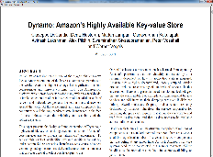





The Amazon NoSQL journey
Oct 2007:
Dynamo paper published
Jan 2012:
DynamoDB general availability
Dec 2004:
Database scalability challenges
Today:
Tier 0 service powering most of Amazon
Q3 2016:
DynamoDB leader in Gartner MQ, Forrester Wave
Notes:
How/Why DynamoDB came to be and how it has evolved into the Tier 0 service it is today.
December 6, 2004: Amazon.com website had multi-hour outage. Peak time for retail.
Root cause – scaled beyond relational database capabilities. The engineering team stepped back and considered a new way
Amazon’s answer to these challenges was Dynamo, which was described in the Dynamo paper, a seminal work defining what was later dubbed NoSQL movement… and inspired other NoSQL projects, including Cassandra.
DynamoDB is tier-0 dependency for MOST of Amazon.
Werner (who was an author of the Dynamo Paper):
“We found that about 70 percent of our operations were key-value lookups, where only a primary key was used and a single row would be returned. With no need for referential integrity and transactions, we realized these access patterns could be better served by a different type of database. Further, with the growth and scale of Amazon.com, boundless horizontal scale needed to be a key design point--scaling up simply wasn't an option. This, ultimately led to DynamoDB, a nonrelational database service built to scale out beyond the limits of relational databases.”

Slide 9






Internet-scale applications
Users | 1M+
Data volume | TB-PB-EB
Locality | Global
Performance | Milliseconds-microseconds
Request rate | Millions
Access | Mobile, IoT, devices
Scale | Incrementally based on traffic
Economics | Pay as you go
Developer access | Instant API access
Notes:
New applications have new requirements.
We need databases that can scale for concurrency (users—simultaneous connections), data volume, reads and writes, and be able to do it incrementally, so that we can handle peaks in traffic and scale back on cost when the traffic goes down…
It’s no coincidence that NoSQL was created around the time when some of the biggest Internet sites, such as Amazon, started to face database scalability challenges.

Slide 10
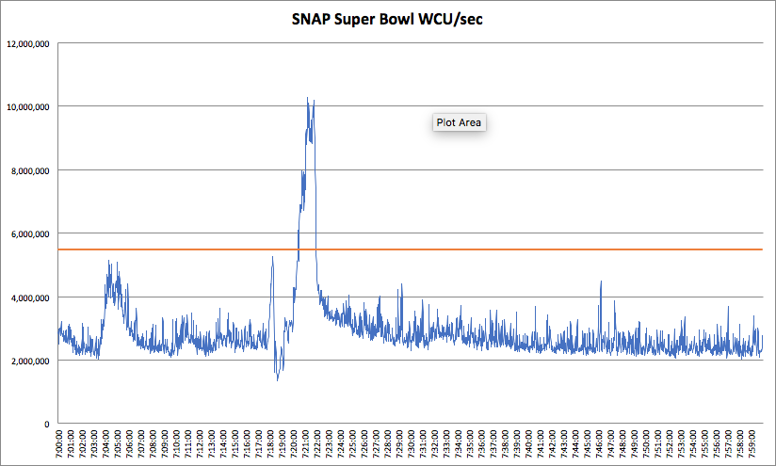
Global-Scale Events: Elastic is the New Normal
Super Bowl
Peak Consumed Capacity
Provisioned Capacity
Write Capacity Units / sec
Notes:
This is the Why of distributed systems: Any-Scale Global Web application with minimal management.
What does scaling look like? → Scaling in action: This is a graph of DynamoDB write traffic during a Global Event: the Super Bowl. 10s of Millions of IOPS per second – with highly variable traffic.
This is from a media company for the 2017 Superbowl was provisioned at 5.5m WCUs –traffic hit 10+ mil at the end of the game! Traffic went from 3.5M WCUs to 10M WCUs in a 1 minute period and then back down to 3.5M.
(aside: over consumption is also allowed due to burst capacity)

Slide 11
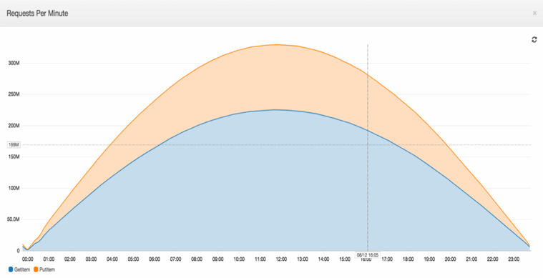
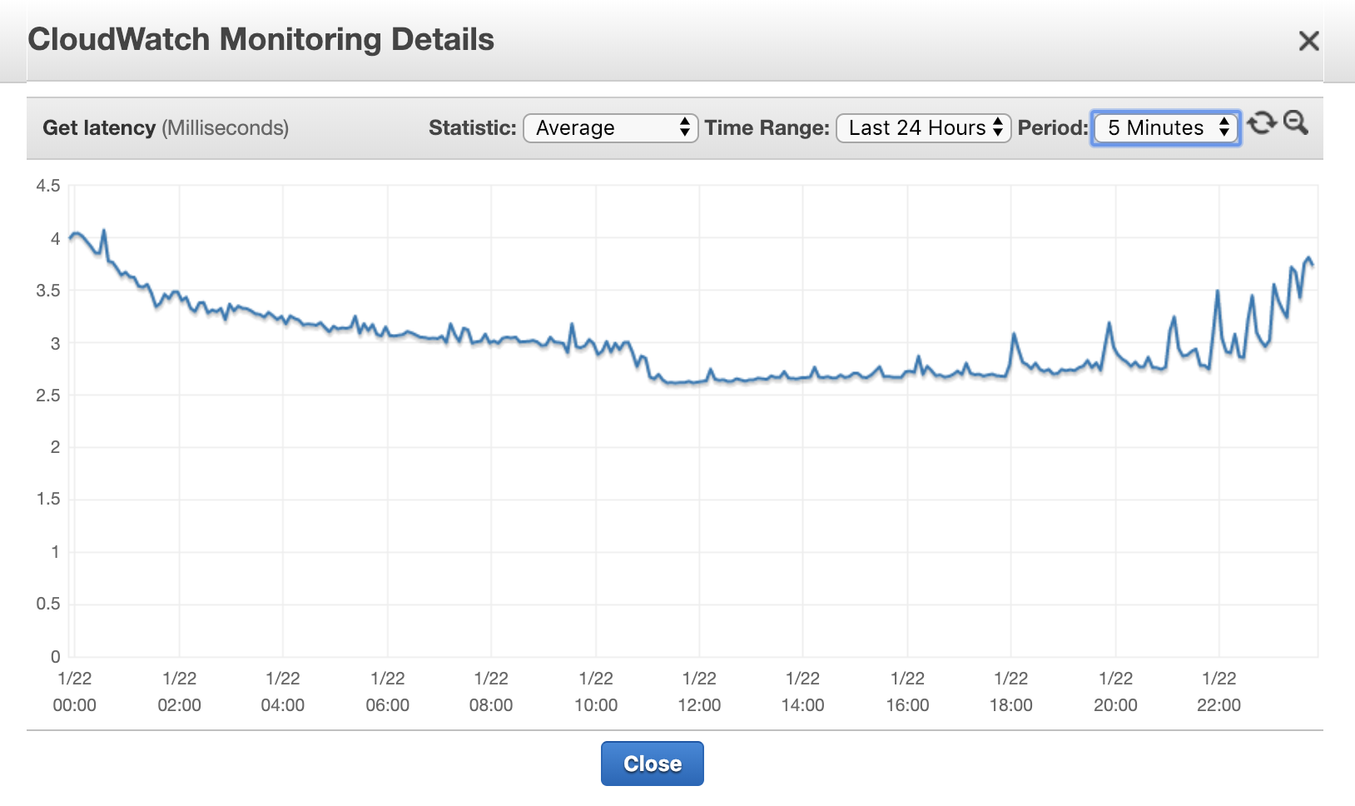
Performance at any scale
High request volume
Consistent low latency
Many millions of requests per second per table
Millisecond variance
Notes:
DynamoDB provides not only high throughput, but also consistent and very predictable responsiveness.
Lower latency at higher load – this is counter intuitive for any data base! 4ms GET latency to 2.5ms average GET latency. Perform equally well for reads/writes.
This was from an Auto Scaling test that we ran: https://aws.amazon.com/blogs/database/amazon-dynamodb-auto-scaling-performance-and-cost-optimization-at-any-scale/

Slide 12
DynamoDB
Fully managed, cloud-native NoSQL database service
Designed for mission-critical OLTP use cases
Where you know access patterns
Operational database that provides:
Extreme scale with horizontal scaling
Consistent performance at any scale
High availability and reliability with zero downtime
Global availability and cross-region replication
Full serverless experience
Integration with AWS Lambda and other AWS services
Notes:
So, what kind of NoSQL database is DynamoDB? Here’s a short summary…
DynamoDB is designed to be used as an operational database in OLTP use cases where you know access patterns and can design your data model for those access patterns. DynamoDB is designed for scale, performance, HA and reliability. DynamoDB is designed for mission-critical applications.
These are some of the things that DynamoDB can bring to your applications.

Slide 13
SQL and NoSQL side by side
SQL
NoSQL
Optimized for storage | Optimized for compute
Normalized/relational | Denormalized/hierarchical
Ad hoc queries | Instantiated views
Scale vertically | Scale horizontally
Good for OLAP | Built for OLTP* at scale
(*) DynamoDB is. Some NoSQL databases are built for analytical workloads.
Notes:
The primary split when considering traditional RDBMS and NoSQL: “Are there Ad hoc queries?” – if yes, then building effective data models is difficult.
An OLTP workload is where 90-95% of access is predefined patterns, we can solve for the 5-10% of ‘other’ queries with other solutions which will be described later.
What does OLTP at scale mean?
- example: supporting shopping cart or session service for millions of users during a large scale online sale event

Slide 14
Scaling databases
Traditional SQL
NoSQL
DB
DB
DB
P1
DB
P2
DB
P3
DB
Pn
Scale up
Scale out to many shards
Basic premise: There is a way to design data that’s horizontally scalable.
Notes:
NoSQL delivers on the promise of massive scale by using horizontal scaling, where data and workload are partitioned over a number of shards that can grow as the data volume and throughput grow. Scaling is incremental, which means more nodes/partitions are added as needed. Nodes are inexpensive, smaller commodity servers, and scaling is nearly linear.
The basic premise is the same for all NoSQL databases: there is a way to shard data that is horizontally scalable.
If this is done right, the performance does not change as the data and throughput grow. Performance at scale was one of the main goals for NoSQL databases – that was certainly true for Amazon DynamoDB.
There are two parts to doing this right:
- 1) the technology has to be able to do it,
- 2) the user has to deploy a good partitioning scheme

Slide 15
You work with tables…
Table 1
Table 2
Table 3
DynamoDB does the rest under the hood…
Server 1
Server N
1K WCU or 3K RCU
up to 10 GB
T1.p1
T1.pn
Notes:
The basic abstraction in DynamoDB is a table. DynamoDB horizontally shards a given table into 1 or more underlying virtual partitions
It enables us to scale to many partitions across many servers.
DynamoDB abstracts the virtual partitions so that you don’t have to worry about them: you use storage, read and write capacity and that’s what you think about. This is the core of the serverless nature of DynamoDB.

Slide 16

Horizontal scaling with DynamoDB
Workload:
data volume, reads, writes
DynamoDB resources:
storage, read, and write capacity
Notes:
As our data workload (data volume, reads and writes) change, DynamoDB transparently scales resources incrementally to accommodate those changes.
To the user, these resources are not servers, but storage, read and write capacity. There are no servers for you to manage, configure, tune or plan capacity for. DynamoDB is serverless and exposes read and write capacity as tunable resources rather than servers.
Serverless does not just mean that you don’t manage servers. It means that servers are not even exposed in any way so that you don’t configure, see servers or plan server capacity.
In fact, with on-demand capacity mode, read and write capacity management is fully automated, and you simply pay for read and write requests you make.

Slide 17
DynamoDB Table
Table
A1 (partition key) | A2 (sort key) | A3 | A4 | A5
A1 (partition key) | A2 (sort key)
Items
A1 (partition key) | A2 (sort key) | A6 | A4 | A5
All items for a partition key
==, <, >, >=, <=
“begins with”
“between”
sorted results
counts
top/bottom N values
paged responses
A1 (partition key) | A2 (sort key) | A3 | A4 | A7
Partition Key
SortKey
Optional
Model 1:N relationships
Enables rich query capabilities
Mandatory
Key-value access pattern
Determines data distribution
Notes:
Let's get the common terminology down. DynamoDB data sits inside what we call a table.
A table is the holder of your data. A table is unique to an account ID and a region. Table name is a String literal. For example, accounts, bookmarks, or IDK "driverless cars".
DynamoDB data sits inside an Item. Conceptually, it is similar to a ‘row.’ It is an atomic unit of data – all operations on items are ACID.
All items must have a partition key. A partition key is also known as a *hash* key. The partition key is important to find your data. Without the partition key we don't know what your data is (we’ll look at how data is organized in a bit). In DynamoDB it is super important that you know what that partition key is. The partition key could be something you derive, or it could be a set of values such as a number between 1 and 1,000.
Optionally, you could have a sort key. A sort key allows for the one to many relationships in DynamoDB. Sort keys are often things like timestamps, version numbers, or audit log IDs. The sort keys are used to create groupings of data. Sort keys are used to sort data on disk. **click** This opens up a lot of query patterns where you can request a range of rows to be returned under a partition key using a BETWEEN statement on the sort key.
When you have a table with a partition key and sort key, the two are collectively your *primary key*. Combined together, the two uniquely identify a single row in DynamoDB. If you give DynamoDB a partition and sort key, we know precisely which row you are referring to.
Because this is a design focused real world use cases presentation, we've gotta talk about indexes.

Slide 18
Global secondary index (GSI)
Up to 20 GSIs per table
RCUs/WCUs provisioned separately for GSIs
Alternate partition and/or sort key
Index is across all partition keys
Use composite sort keys for compound indexes
Table
A1 (partition) | A2 (sort) | A3 | A4 | A5
Item keys copied automatically for uniqueness
A2 (partition) | A1 (sort)
KEYS_ONLY
A5 (partition) | A4 (sort) | A1 (item key) | A2 (item key) | A3 (projected)
INCLUDE A3
GSIs
A4 (partition) | A5 (sort) | A1 (item key) | A2 (item key) | A3 (projected)
ALL
Notes:
GSI, or global secondary index, allows you to have an alternate schema on your DynamoDB table. GSIs underneath are actually DynamoDB tables, however, when you go to your AWS management console and you go to your Dynamo table, you won't see your GSI listed next to your other tables. Instead, they're under the indexes tab on your Dynamo table.
So, what makes GSIs unique? Only DynamoDB can write to global secondary indexes. DynamoDB is responsible for copying data from your base table into your global secondary index. Because this is a separate DynamoDB table, it is asynchronously updated. So put it another way, GSIs can be kind of stale on the order of milliseconds of staleness, potentially more depending on the situation.
The most important thing that you can do for a global secondary index is to make sure you have enough provisioned capacity, or you use the DynamoDB on demand mode (we’ll look at how to provision capacity a little later).
When you're working with GSIs, you can choose whatever arbitrary schema you want. You get up to 20 global secondary indexes, you choose whatever partition key you want. Now, as I mentioned, it's important to have a good unique partition key value. You don't want some low-cardinality order status as your GSI partition key because DynamoDB uses that partition key to figure out where your data's going to be stored. And if you are inserting a thousand orders per second with a status of new, that's all going to go to one Dynamo partition if the order status is your partition key.

Slide 19
Data types
Operation types
Data Type | DynamoDB Type
String | String
Integer, Float | Number
Timestamp | Number or String
Blob | Binary
Boolean | Bool
Null | Null
List | List
Set | Set of String, Number, or Binary
Map | Map
Data Operations
Query
Scan
GetItem
BatchGetItem
PutItem
BatchWriteItem
UpdateItem
DeleteItem
TransactWriteItems
TransactReadItems
Notes:
Data Types and Operations supported natively. Indexes only support Scalar types (String, Number, Binary)
All operations are REST APIs → SDK/CLI/Console
Put, Update, Delete, and TransactWriteItem support operation conditions on top level attributes, limited internal nested support.
Lists & Maps support specific update operations like Append/Prepend.
Numbers support incremental counter/decrement operations.
Query: Very powerful retrieval operation. It allows for retrieving many items, which are share a single partition key, as a single unit.
-- i.e. Query userID for all profile rows… if there were 12 rows and each one is 1KB, this would be 3 Read Units (or 1.5 RCUs if done as an Eventually Consistent Read). If these same operation were done as a BatchGetItem it would be a minimum of 12 RCUs (or 6 if done as EC reads).
Scan: Primarily used for ETL or sampling data. It is only used in edge cases for normal production workloads.
GetItem & BGI: Get Item is a singleon operation to retrieve and item. GBI retrieves up to 100 single operations as a single API call.
PutItem & BWI: Puts a single item. BWI inserts up to 25 items as a single API call.
Update: Updates an existing item. (Consumes the full item’s size as a write operation).
Delete: Removes an existing item. (Consumes the full item’s size as a write operation).
TransactWriteItem: Operations on up to 25 items as a single atomic operation. Success/Fail (no open/blocking/roll back). Supports conditions and checks.
TransactReadItem: A read that is consistent with a transaction that is being written.

Slide 20

Item Distribution (happy path)
Aggregates
Partition key
DynamoDB table
Hash.MIN = 0
Orders
00
Partition A
OrderId: 1
CountryCode: 1
ASIN: [B00X4WHP5E]
Hash(1) = 7B
55
Partition B
OrderId: 2
CountryCode : 1
ASIN: [B00OQVZDJM]
Keyspace
Hash(2) = 48
AA
OrderId: 3
CountryCode : 1
ASIN: [B00U3FPN4U]
Partition C
Hash(3) = CD
FF
Hash.MAX = FF
Related data (aggregate) is stored together for efficient access
Notes:
So – how do items work in a table? Items that are inserted are hashed by partition key and distributed over virtual partitions.
Demonstrate how the partition key is used to hash and distribute items over the table’s key space (and the underlying partitions).
This means that even if partitions keys share a leading prefix, or are sequentially increasing – they will randomly distributed over the underlying virtual partitions.

Slide 21

Three-way replication
A view “from a different angle”
Data is always replicated to three Availability Zones
The service runs in three Availability Zones
OrderId: 1
CustomerId: 1
ASIN: [B00X4WHP5E]
Hash(1) = 7B
Availability Zone A
Availability Zone B
Availability Zone C
Partition A
Partition C
Partition A
Partition B
Partition C
Partition A
Partition C
Partition B
Partition A
Partition B
Host 1
Host 2
Host 3
Host 4
Host 5
Host 6
Host 7
Host 8
Host 9
CustomerOrdersTable
Notes:
When an item is written it is replicated across 3 AZs (we will see how this works in the next slides).
Writes are reliable & Data is durable and HA.

Slide 22


Service at Scale
RR
RR
RR
RR
RR
RR
RR
RR
RR
RR
RR
RR
RR
RR
RR
RR
RR
RR
RR
RR
RR
RR
RR
RR
RR
RR
RR
RR
RR
RR
Network
RR
RR
RR
RR
RR
RR
RR
RR
RR
RR
RR
RR
RR
RR
RR
Notes:
The DynamoDB Service is composed of many thousands of automated servers in two primary fleets:
The front end: Request Routers, which are stateless and route incoming HTTPS requests to the appropriate node in storage layer.
The back end: Storage Nodes, which are stateful and store every item (replicated three times).

Slide 23
Path of a PutItem request
RR
RR
RR
RR
RR
AVAILABILITY
ZONE 1
RR
RR
RR
RR
RR
RR
RR
RR
RR
RR
RR
RR
RR
RR
RR
AVAILABILITY
ZONE 2
RR
RR
RR
RR
RR
RR
RR
RR
RR
RR
Network
RR
RR
RR
RR
RR
AVAILABILITY
ZONE 3
RR
RR
RR
RR
RR
RR
RR
RR
RR
RR
Notes:
Let’s see how this works by examining a PutItem request first.
When a client issues a write to a DynamoDB table, the request router will connect to the leader storage node for that item to submit the request.
That leader storage node replicates the change to two replica storage nodes in two other AZs. When one of the two SNs confirms an item is written, the 200 ok is sent to the client.
Using this model, DynamoDB could sustain the outage of an entire AZ and continue to serve traffic!
Yes, the three storage nodes operate using a leader/replica model that we will discuss in a moment.

Slide 24
GetItem Consistency
STORAGE NODE
SSD
SSD
SSD
SSD
SSD
SSD
SSD
SSD
SSD
EVENTUALLY
CONSISTENT
STORAGE NODE LEADER
EVENTUALLY
CONSISTENT
STRONGLY
CONSISTENT
REQUEST ROUTER
SSD
SSD
SSD
SSD
SSD
SSD
SSD
SSD
SSD
Network
EVENTUALLY
CONSISTENT
STORAGE NODE
SSD
SSD
SSD
SSD
SSD
SSD
SSD
SSD
SSD
Notes:
As we described – when an item is confirmed as written, it is on disc in 2 of the 3 storage nodes. When a strongly consistent read is issued, it goes to the Storage Leader node – this ensures that the most up to date version of that item is returned. When an eventually consistent read is issued – it is randomly sent to one of the three backend storage nodes.
The 3rd storage node is updated very very quickly, so the window for ‘stale’ reads is very small. EC/SC reads can be configured per request. EC reads consume 50% of the RCU capacity!
---
How far behind might replication to the third replica be? That will depend – it may be behind because it has just rebooted, or the storage node was automatically failed out and replaced – or perhaps a temporary network hiccup – because of the variables we do not provide any guarantees around this – that is the nature of eventual consistency. Under normal operating conditions it will typically be a matter of a few milliseconds behind the leader node

Slide 25
CAP Theorem
DynamoDB is both CP & AP
Partition Tolerance
All Writes
Consistent Reads
TransactReads
Eventually Consistent Reads
Availability
Consistency
Notes:
If you’ll recall your computer science, the CAP theorem proposes that in a database system, only 2 of three (C, A, or P) can be present at any moment.
By using Eventually Consistent reads – DynamoDB is AP.
All writes, and Strongly Consistent reads, are CP on DynamoDB. (And nearly AP as it can tolerate an AZ failure and elect new leaders quickly…)

Slide 26
Heartbeats
STORAGE NODE
SSD
SSD
SSD
SSD
SSD
SSD
SSD
SSD
SSD
STORAGE NODE LEADER
REQUEST ROUTER
SSD
SSD
SSD
SSD
SSD
SSD
SSD
SSD
SSD
Network
STORAGE NODE
SSD
SSD
SSD
SSD
SSD
SSD
SSD
SSD
SSD
Notes:
Leader election is managed using Paxo.
StorageNode Leader Election: DynamoDB achieves designating a leader among the storage nodes amongst themselves using a heartbeat protocol with the Paxos algorithm.
StorageNode Leader Heartbeating: Each of the storage nodes participate in a membership group and heartbeat amongst each other every 1.5 seconds. If the leader heartbeats are not received, one the other storage nodes will offer to take over as leader, and one of the nodes with the latest version will be elected.

Slide 27
Global Secondary Index
STORAGE NODE
STORAGE NODE
SSD
SSD
SSD
SSD
SSD
SSD
SSD
SSD
SSD
SSD
SSD
SSD
SSD
SSD
SSD
SSD
SSD
SSD
STORAGE NODE
STORAGE NODE
SSD
SSD
SSD
SSD
SSD
SSD
RR
SSD
SSD
SSD
LOG
PROPAGATOR
SSD
SSD
SSD
SSD
SSD
SSD
SSD
SSD
SSD
Network
STORAGE NODE
STORAGE NODE
SSD
SSD
SSD
SSD
SSD
SSD
SSD
SSD
SSD
SSD
SSD
SSD
SSD
SSD
SSD
SSD
SSD
SSD
BASE TABLE
INDEX
Notes:
Fundamentally – a GSI is simply another table that DynamoDB is asynchronously updating for you, using the log propagator service. Only items written to the base table that match the primary index are written to the GSI.
--
Note that if none of the selected projection attributes for a GSI have changed, there is no write to be made and no WCU consumption in the GSI. Your choice of attributes for the GSI primary key may result in a sparse index. So the write consumption (WCU) in a GSI can in some cases be lower than the base table.

Slide 28
Global Secondary Index
STORAGE NODE
SSD
SSD
SSD
SSD
SSD
SSD
SSD
SSD
SSD
STORAGE NODE
SSD
SSD
SSD
SSD
SSD
SSD
STORAGE NODE
SSD
SSD
SSD
SSD
SSD
SSD
SSD
SSD
SSD
STORAGE NODE
SSD
SSD
SSD
SSD
SSD
SSD
DELETE
SSD
SSD
SSD
STORAGE NODE
SSD
SSD
SSD
SSD
SSD
SSD
OLD INDEX PARTITION
RR
SSD
SSD
SSD
LOG
PROPAGATOR
SSD
SSD
SSD
STORAGE NODE
Network
STORAGE NODE
PUT
SSD
SSD
SSD
SSD
SSD
SSD
SSD
SSD
SSD
SSD
SSD
SSD
SSD
SSD
SSD
SSD
SSD
SSD
BASE TABLE
STORAGE NODE
SSD
SSD
SSD
SSD
SSD
SSD
SSD
SSD
SSD
STORAGE NODE
SSD
SSD
SSD
SSD
SSD
SSD
SSD
SSD
SSD
NEW INDEX PARTITION
Notes:
Optional slide – additional GSI behavior….
1/ On the other hand, the GSI can consume capacity as more than the write capacity of the base table
2/ if your choice of primary key in the GSI is different than the base table, updating an attribute in a base table item could consume one write, and if the mutated attribute is part of the primary key for the GSI it will involve deleting the index item and then creating it again with the new primary key value.
3/ Think about our earlier customer database example. The base table has a primary key of customer id, and another attribute for the name – the GSI actually uses the name attribute for its primary key. If we have a customer with id 123 and name Robert, and then we update that item because the customer would like to be known as Bob instead, projecting this update into the GSI will mean deleting the index item with primary key “Robert” and replacing it with a new item with primary key “Bob”. So a single update of a base table item can result in 2x amplification of writes to a GSI.
4/ A reminder we recently increased the limit on GSIs per base table to 20 so it’s worth keeping this amplification cost in mind when designing/managing GSIs to manage costs

Slide 29
Auto Admin
Create tables and indexes
Table and index provisioning
Splitting partitions
Partition repairs
… (DBA for DynamoDB)
AUTO
ADMIN
Notes:
It is worth noting that there is not an ops team managing all this, infact – all of the regular ‘dba-like’ tasks are managed by an Auto Admin service.
1/ It’s like the automatic DBA for DynamoDB and it accounts for a lot of the value you receive from the product.
2/ It takes care of table and index creation, provisioning of capacity for them, splitting partitions as necessary to accommodate growing data volume or higher throughput requirements, and it repairs any problems that might arise for a storage node serving your partitions.
3/ This is what allows the DynamoDB service team to manage many thousands of servers, and it allows you to experience DynamoDB as serverless and highly available, with scaling elasticity from tiny to… well, the sky is the limit - and you only pay for the storage and the throughput you need.

Slide 30
Managing Throughput
Notes:
Let’s move on from overall system management and focus for a while on how DynamoDB manages your throughput.

Slide 31
Scaling
Throughput
Provision any amount of throughput to a table
Write Capacity Unit (WCU) – 1 KB per second
Read Capacity Unit (RCU) – 4 KB per second
Independent of each other
Size
Add any number of items to a table
Max item size is 400 KB
Scaling is achieved through partitioning
Each virtual partition delivers 1000 writes/second or 3000 reads/second
By Capacity = (Total RCU / 3000) + (Total WCU/1000)
By Size = Total Size / 10 GB
Notes:
At table creation time you specify :
Table Name & Keys : primary/sort
WCU : write capacity unit (1 KB/sec)
RCU : read capacity unit (4 KB/sec)
Storage size of the table automatically increases as you add more items. There is a limit of item size at 400KB.
As more items are added as size increases, the table is partitioned automatically for you. Size and provisioning capacity of the table are equally distributed for all partitions. And new partitions are added when either the capacity or size exceeds the formula above.

Slide 32
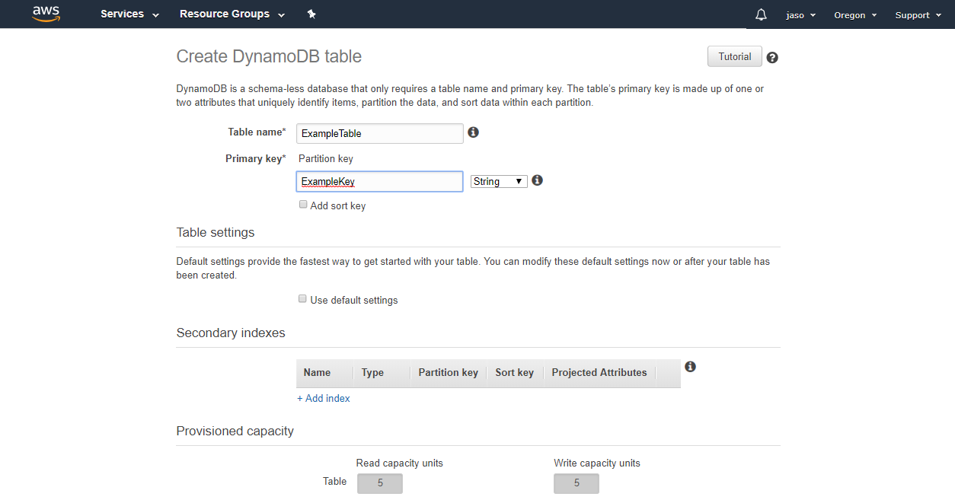
Provisioning Table Capacity
Notes:
As mentioned, a single write capacity unit will allow you to write an item up to 1KB in a given second. A read capacity unit lets you read up to a 4KB item in the second with strong consistency, or two of those item reads with eventual consistency. DynamoDB billing is based on the data volume stored, and throughput.
In November 2018 we introduced a new throughput mode called On-Demand, which adds some predictive intelligence to split out your partitions ahead of time - and for On-Demand tables you pay-per-use rather than specifying a particular throughput.
Let’s walk through some of the fundamentals of managing this from the DynamoDB service perspective so you can better understand the ways we’re improving the customer experience.

Slide 33
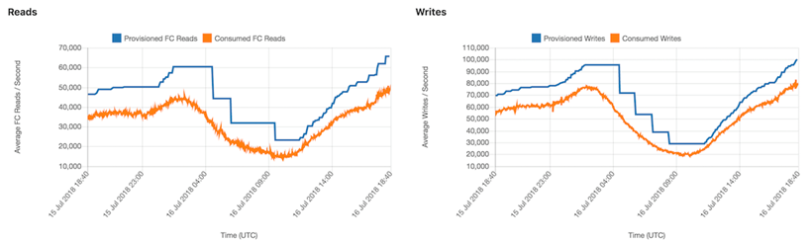
Auto Scaling
Notes:
Auto Scaling is on by default for provisioned mode tables – as insurance against throttling for unexpected load peaks, as a means to optimize your spend, or both.
Here are some graphed metrics for an actual customer workload. You can see that the load has a seasonal variability – in this case daily peaks and troughs associated with user activity levels throughout the day.
Auto Scaling is helping this customer to pay only for the throughput they need, and it is also protecting them from application impact due to under-provisioning if they should see an uncharacteristically high load.

Slide 34

Token Buckets Manage Provisioned Throughput
TABLE
BURST
TABLE & BURST BUCKETS
5
1
2
6
STORAGE NODE
REQUEST ROUTER
SSD
SSD
SSD
SSD
SSD
SSD
SSD
SSD
SSD
Network
3
4
AUTHENTICATION SYSTEM
PARTITION METADATA SYSTEM
Storage Node 3,000 RCUs or 1,000 WCUs
Notes:
Capacity is managed at the table level and the storage node level using token buckets. The token buckets for both levels are ‘refilled’ each second and if the bucket is depleted (and the burst bucket is depleted), then requests are throttled – or ‘rate-limited.’
Requests are admitted by the request router if there are tokens in the bucket for the table (either in the table or burst bucket). Requests are then sent to the storage nodes, which will serve requests if there are tokens in the storage node token buckets.
The table level bucket is proportionate to the provisioned capacity on the table. Adaptive Capacity ensures that the storage node buckets are always 3,000 RCUs or 1,000 WCUs, which allows the full throughput of each partition to be used as long as table level capacity is not exceeded.
This is the same design for GSIs.

Slide 35
DynamoDB on-demand capacity mode
No limit
Features
No capacity planning, provisioning, or reservations—simply make API calls
Pay only for the reads and writes you perform
Key benefits
Eliminates tradeoffs of overprovisioning or underprovisioning
Instantly accommodates your workload as traffic ramps up or down
Start at zero
Notes:
We launched on-demand capacity in November 2018 to help our customers with unpredictable or very spiky workloads.
With on-demand capacity, there is no planning for capacity – you simply consume what you need with no throttling, and pay only for those read and write requests.

Slide 36
On-demand scaling properties
Base throughput
Up to 4,000 write request units: 4,000 writes per second
Up to 12,000 read request units: 24,000 eventually consistent reads per second
Any linear combination of the two
Maximum throughput
Unlimited!
Pay per request: Use nothing, pay nothing
Notes:
Under the hood – the storage node layer works very similarly.
With on-demand, your table is initially created to support up to 4K write requests or 12K read requests (or a combination of the two). But you can continue to grow your use as far as you like (unless you hit an account limit, which you can always get increased).
We often get questions about how it can handle this traffic instantaneously, so I like to talk about how we manage capacity on tables using on-demand capacity. We create additional headroom on the table when it’s created, and at any point in the future when traffic ramps up. We guarantee that you can always hit up to two times your previous peak without any performance impacts. I’ll talk more about how we partition data in the next section, but the key is the on-demand is performance oriented and accommodates your workloads without any planning and forecasting overhead. A bit more on 2x previous peak.

Slide 37
Maximum throughput
“Up to twice your previous peak”
New peak set
New peak set
DynamoDB request rate
New peak set
Notes:
We ask customers to pre-warm a table by driving test traffic at the rate they expect before accepting live traffic. This will ensure the table is prepared to receive all the expected traffic (even up to 2x).

Slide 38
Adaptive Capacity High Traffic Isolation
High-traffic item isolation
Partition A
Notes:
Let’s take a look at under the hood….this initially was only active on On-Demand, but it is now available for all tables!
If you recall – a partition on DynamoDB supports up to 3k RCUs or 1K WCUs (or a linear combination of the two). Contrary to popular belief – capacity is not ‘evenly split’ across partitions, but rather – each partition can use up to its maximum allowance as long as the table is not exceeding its provisioned through put (even then there is the burst capacity).

Slide 39
Adaptive Capacity High Traffic Isolation
Item “foo”
Item “bar”
Partition A
Notes:
Let’s say that there is a ‘virtual partition’ supporting the table with with 2 ‘hot’ items.
Example: Social media – Kardashians.

Slide 40
Adaptive Capacity High Traffic Isolation
Item “foo”
Item “bar”
Partition A
Partition B
Notes:
DynamoDB will identify this – and split the key space over 2 different partitions… this effectively doubled the throughput potential for each of these partitions and isolating the high traffic keys!

Slide 41
Adaptive Capacity High Traffic Isolation
Item “foo”
Item “bar”
Partition A
Partition B
Notes:
If one of those items is exceptionally hot – DynamoDB will take further action and isolate it onto its own partition. In the above – there is now 3x the available throughput for the same keyspace that we started with! This is all automatically tracked and adjusted for all tables in all regions!

Slide 42
Adaptive Capacity - now
Amazon Confidential
Notes:
<The following Adaptive Capacity slides are an alternative way to discuss the ability to isolate traffic based on key access heat>
Did you know that DynamoDB can handle imbalances in keyspace access on the fly?
Let’s say there are three partitions supporting N keys….

Slide 43
Adaptive Capacity - now
Amazon Confidential
Notes:
One of them starts getting disproportionate traffic.....

Slide 44
Adaptive Capacity - now
Amazon Confidential
Notes:
The partition actually splits.....

Slide 45
Adaptive Capacity - now
Notes:
...and traffic starts being redirected to the new dynamically created buckets.

Slide 46
Adaptive Capacity - now
Amazon Confidential
Notes:
And if the traffic starts to overload again.....

Slide 47
Adaptive Capacity - now
Amazon Confidential
Notes:
....The partition will split again....

Slide 48
Adaptive Capacity - now
Amazon Confidential
Notes:
...and redistribute the traffic again. You now have all of these partitions that are equally sized and balanced with each other. And you as the developer didn’t have to do a single thing. AWS literally adjusts our service to fit your usage patterns.
This can ultimately result in a SINGLE key on a SINGLE partition – which shifts the ‘limits’ to 1k WCUs or 3k RCUs per item…

Slide 49
Data Models for Horizontally Distributed Systems
Notes:
Now that we understand the architecture of DynamoDB, we can start to look at how to take get the most out of it as a distributed system.

Slide 50
Partition key
A good sharding (partitioning) scheme affords even distribution of both data and workload as they grow
Key concept: partition key as the dimension of scalability
Distribute items across partitions – horizontal scaling
Ideal scaling conditions:
The partition key is from a high cardinality set (that grows)
Requests are evenly spread over the key space
Requests are evenly spread over time
Notes:
It is important to model data in such a way that it can be distributed evenly over the underlying virtual partitions – this is the basis of ‘good key design.’
There are three rudimentary relationships that can be built on DynamoDB. These relationships can be built into more complex data models.

Slide 51
One-to-one relationships or key-values
Use a table or GSI with a partition key
Use GetItem or BatchGetItem API
Example: Given a user or email, get attributes
Users table
Partition key | Attributes
UserId = bob | Email = bob@example.com, JoinDate = 2011-11-15
UserId = fred | Email = fred@example.com, JoinDate = 2011-12-01
Users-Email-GSI
Partition key | Attributes
Email = bob@example.com | UserId = bob, JoinDate = 2011-11-15
Email = fred@example.com | UserId = fred, JoinDate = 2011-12-01
Notes:
Key/values access patters (Map, Dictionary…)

Slide 52
One-to-many relationships or parent-children
Use a table or GSI with a partition and sort key
Use the Query API to get multiple items
Example: Given a device, find all readings between epoch X, Y
Device-measurements
Part. key | Sort key | Attributes
DeviceId = 1 | epoch = 5513A97C | Temperature = 30, pressure = 90
DeviceId = 1 | epoch = 5513A9DB | Temperature = 30, pressure = 90

Slide 53
Many-to-many relationships
Use a table and GSI with the partition and sort key elements switched
Use the Query API
Example: Given a user, find all games. Or given a game, find all users.
User-Games-Table
Part. key | Sort key
UserId = bob | GameId = Game1
UserId = fred | GameId = Game2
UserId = bob | GameId = Game3
Game-Users-GSI
Part. key | Sort key
GameId = Game1 | UserId = bob
GameId = Game2 | UserId = fred
GameId = Game3 | UserId = bob

Slide 54








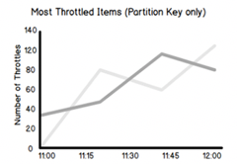
DynamoDB
Feature Highlights
Time To Live (TTL)
DynamoDB Accelerator (DAX)
Auto scaling
On-demand backup
Global tables
Encryption at rest
Point-in-time
recovery
Adaptive capacity
99.999% SLA
ACID
Transactions
SLA
DynamoDB
local
NoSQL Workbench
CloudWatch Contributor Insights

Slide 55
Takeaways
Internet scale applications gave rise to NoSQL
New paradigm: use the right database for each job
DynamoDB is for mission-critical OLTP use cases
Distributed NoSQL scales horizontally
As long as you select a good partitioning scheme
You can model relationships in NoSQL
NoSQL is hard to operate at scale
Use DynamoDB!

